Slide 1
Relation between the food cuisines in top cities of india

Slide 2
Abstract
Identifying the popular food cuisines in the top cities of India as well as to identify the similarities between the food cuisines of these cities would help the people who are looking to set up a restaurant in this cities and will also help the people who are trying to establish a chain of restaurants across this cities.
It will help the people by providing which type of food cuisine is most popular in that particular city and which cities have the similar type of food cuisines.

Slide 3
Objective
The final objective of this project will to understand the food cuisines that is popular among the people of a city and the similarity in the food cuisines among the people of different cities. The end result will be a KMeans model clustering the cities based on similarities and the clusters being visualized.

Slide 4
Methodology
This project follows the following Methodology:
1.Collecting the data
2.Cleaning the data
3.Visualization
4.Machine Learning

Slide 5
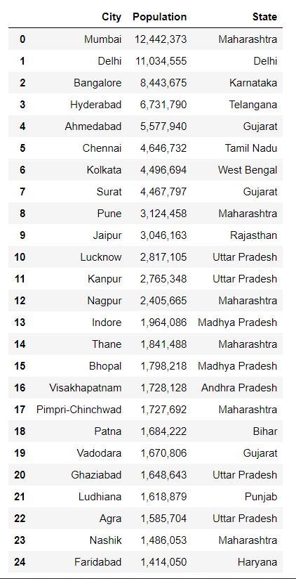
Collecting data
The datasets used in this notebook are collected from Wikipedia. The data from wikipedia is scraped with the help of beautiful soup.
The Foursquare data, will be added within the notebook and no external file will be created for it. The API calls will be made within the code cell. Once the necessary data is collected, cleaning the data is done.

Slide 6
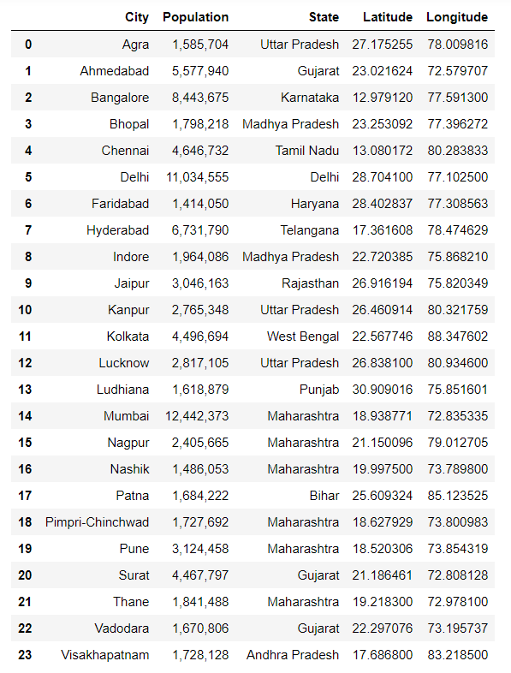
Cleaning Data
There is not much of data cleaning done here as only required data was scraped from the wikipedia page and the coordinates are calculated with the help of geolocater. The city named Gaziabad is removed from the data as Foursquare API was not able to process it.

Slide 7
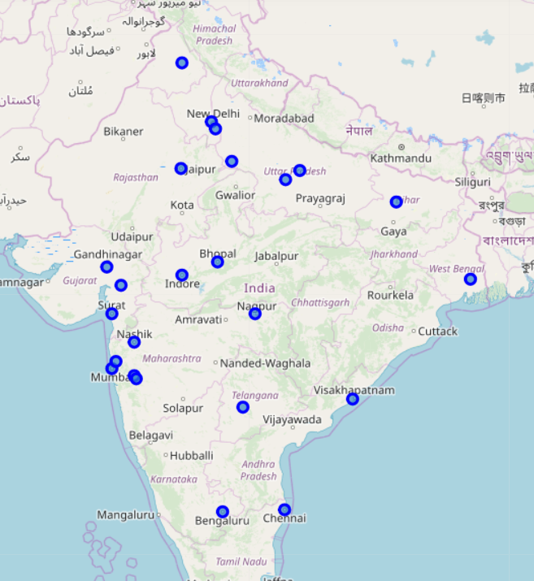
Visualization
A few simple visualizations are made in order to get a better understanding of the data. Folium is used for this purpose. Folium generates interactive and beautiful maps, using the Latitude and Longitude we provide. The folium visualizations will be made available in the comments section. Further to enhance the understanding of the data, count plots are used to better understand the final result.

Slide 8
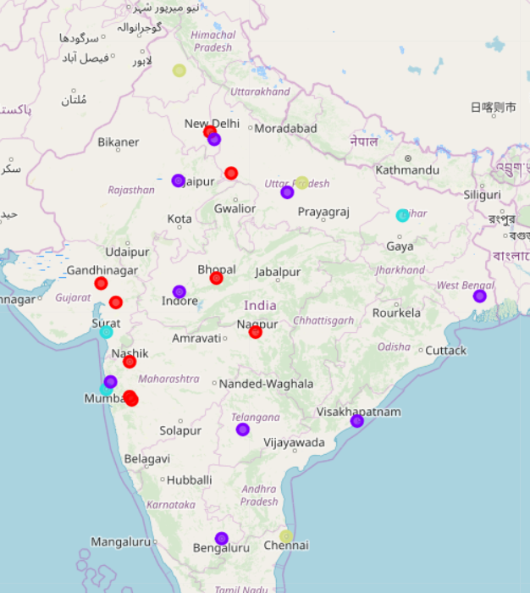
Machine Learning
KMeans clustering algorithm is used on the most common venues dataframe to identify the probable clusters for different types of restaurants. we have initialized 4 clusters for the dataset.

Slide 9
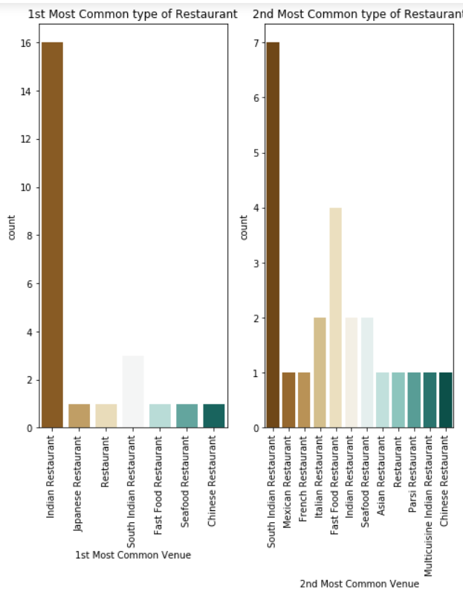
Results
Indian restaurants are the 1st most popular preferred type of food in the indian cities.
South Indian restaurants along with Fast food restaurants are the 2nd most popularly preferred type of food in the indian cities.

Slide 10
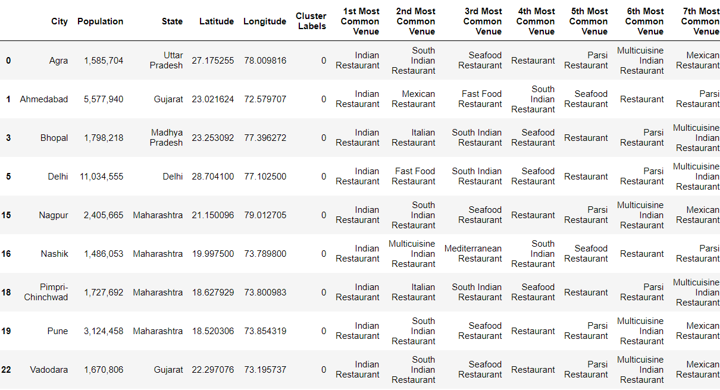
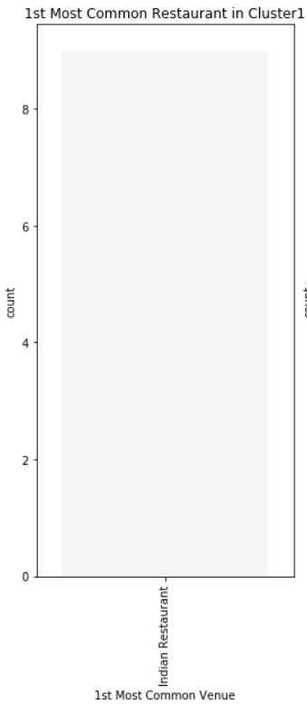
Results contd..
The cities 'Agra', 'Ahmedabad', 'Bhopal', 'Delhi', 'Nagpur', 'Nashik', 'Pimpri-Chinchwad', 'Pune', 'Vadodara' are grouped together. With Indian restaurant being the 1st most famous type restaurant among them.

Slide 11
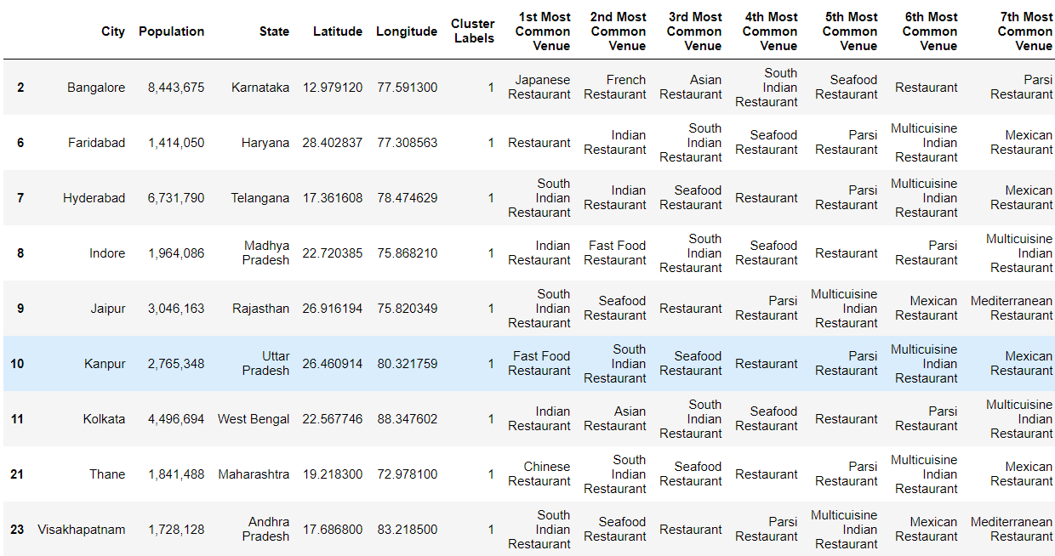
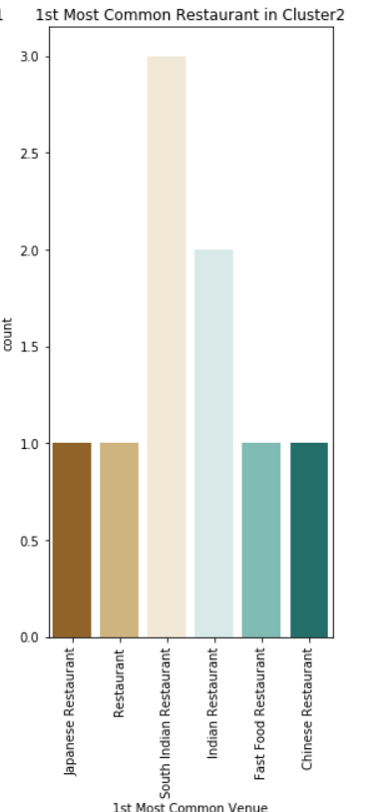
Results contd..
The cities 'Bangalore', 'Faridabad', 'Hyderabad', 'Indore', 'Jaipur', 'Kanpur', 'Kolkata', 'Thane', 'Visakhapatnam' are grouped together. With South Indian restaurant being the 1st most famous type restaurant along with Indian Restaurant among them.

Slide 12
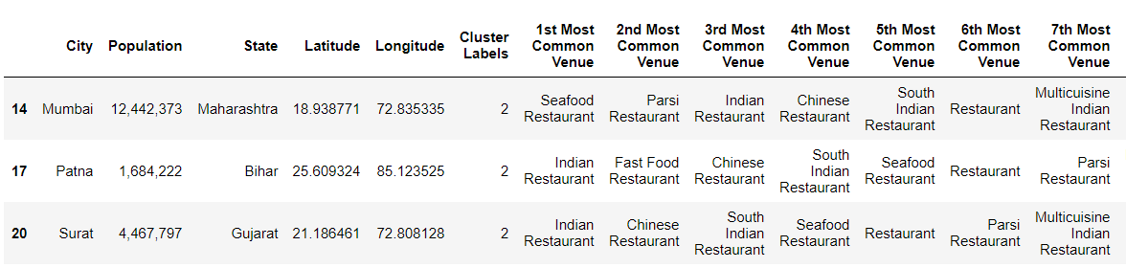
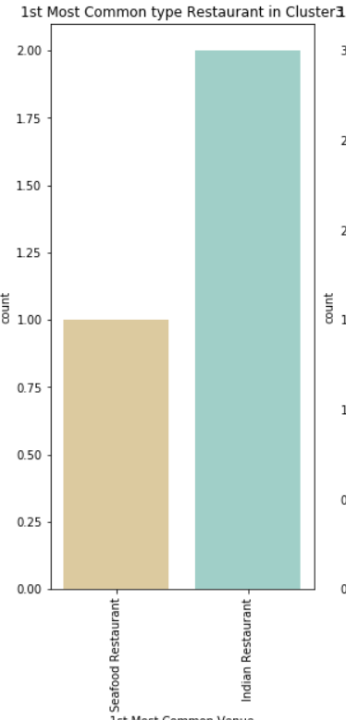
Results contd..
The cities 'Mumbai', 'Patna', 'Surat',are grouped together. With Indian restaurant being the 1st most famous type of restaurant among them.

Slide 13
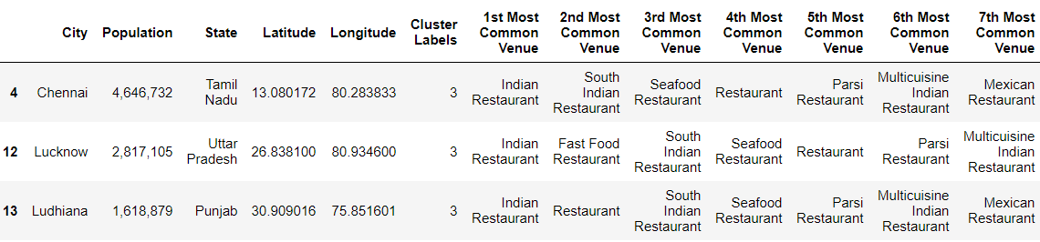
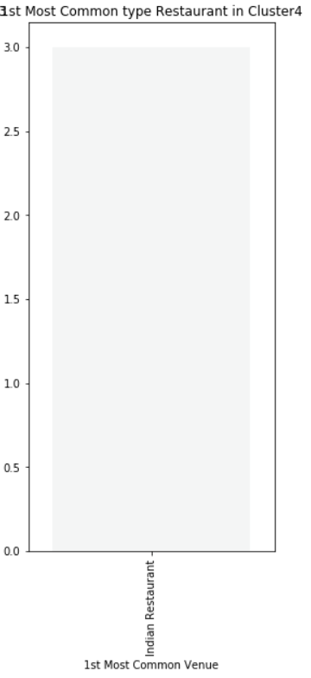
Results contd..
The cities 'Chennai', 'Lucknow', 'Ludhiana',are grouped together. With Indian restaurant being the 1st most famous type of restaurant among them.

Slide 14
Future directions
This project can be extended to include not only the data related to restaurants but also other aspects like sports locations, entertainment venues, etc.

